Slide 1
Where, oh where, should I open a Pet Store in Toronto?

Slide 2
The data…
Toronto Open Data: Licensed Dogs and Cats Reports for 2013 and 2017 by FSA (*FSA = Forward Sortation Area (first 3 characters of a Canadian Postal Code)
Population by FSA from Census 2016
FourSquare Api: to get number of pet stores/services per FSA
geopy: to get lat/long coordinates for each FSA

Slide 3
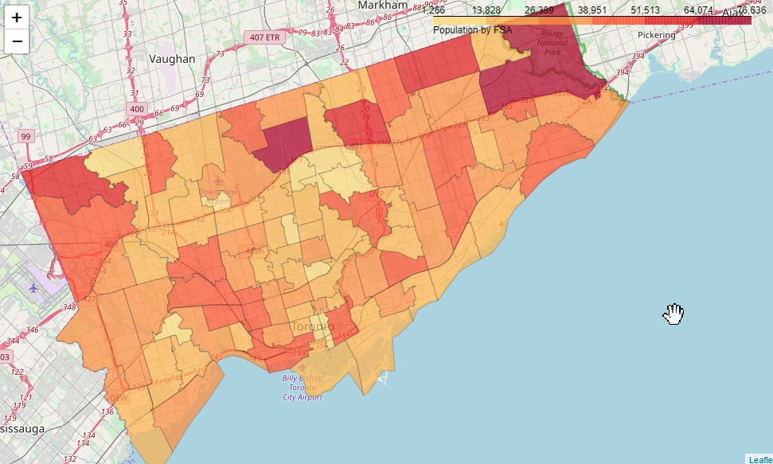
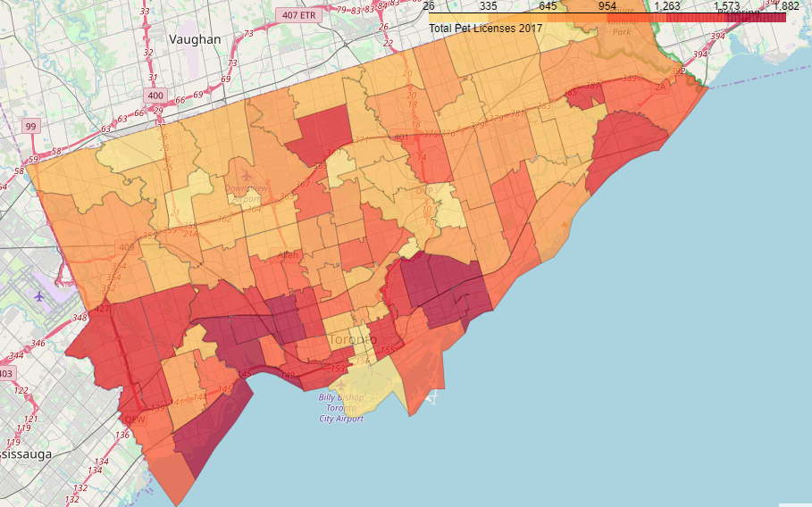
Pet Ownership in Toronto 2017
Population (2016)
Total new Pet Licenses Issued (2017)
Largest # Licenses are outside downtown core: East York (M4C) and Etobicoke (M8V) rank highest
Lowest #s are in the downtown core: M5C, M5H and M5W rank lowest

Slide 4
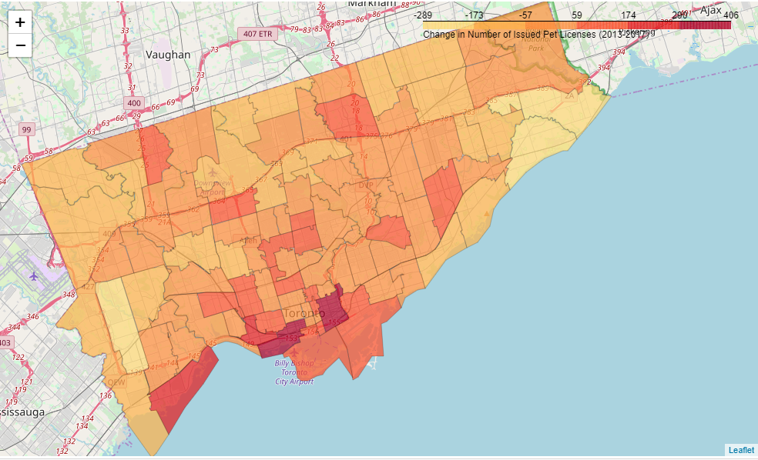
Changes in Pet Licensing: 2013 - 2017
Downtown Toronto (M5A and M5V) experienced the largest pet growth (+ 399 and 362 respectively)
this could be due to population growth downtown with all the new condos
Scarborough and Etobicoke (M1C and M9B) experienced the biggest decrease in pet licensing (-282, -203)

Slide 5
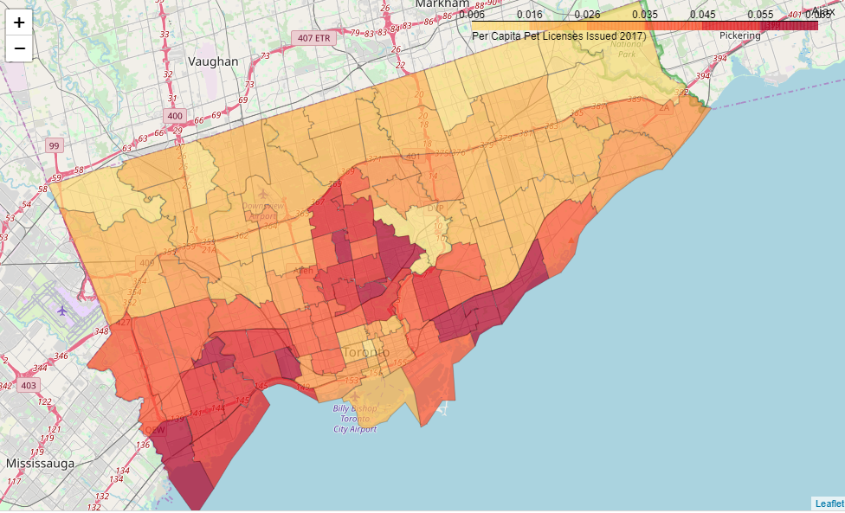
Per Capita Pet Licensing
The highest per capita ownership of pets is in
The Beaches (M4E):
Parkdale/ Roncesvalles (M6R)
Alderwood/Long Branch(M8W)

Slide 6
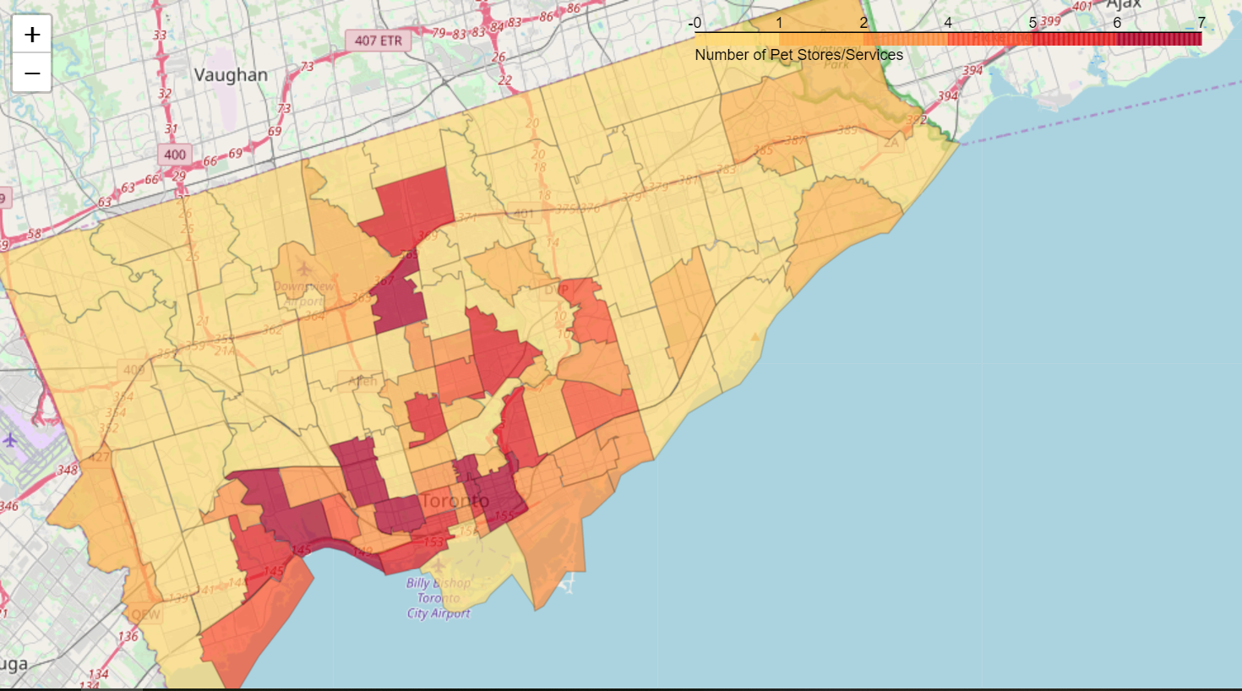
Existing Pet Services/Stores
Data provided by FourSquare

Slide 7
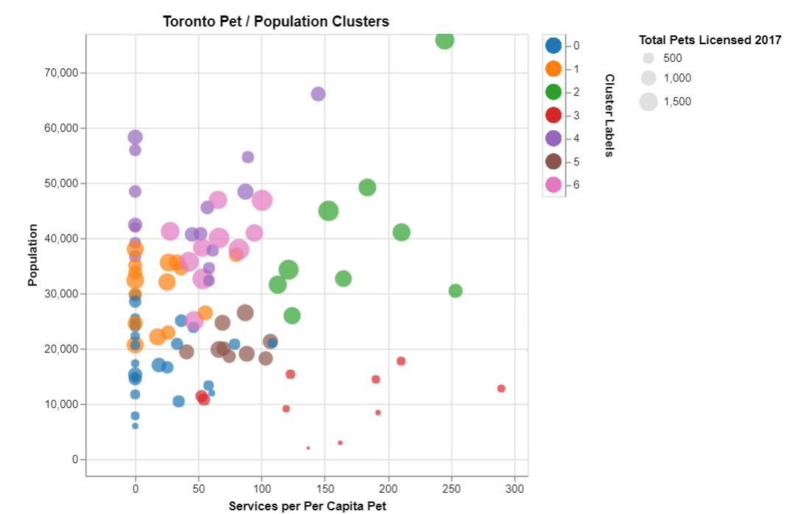
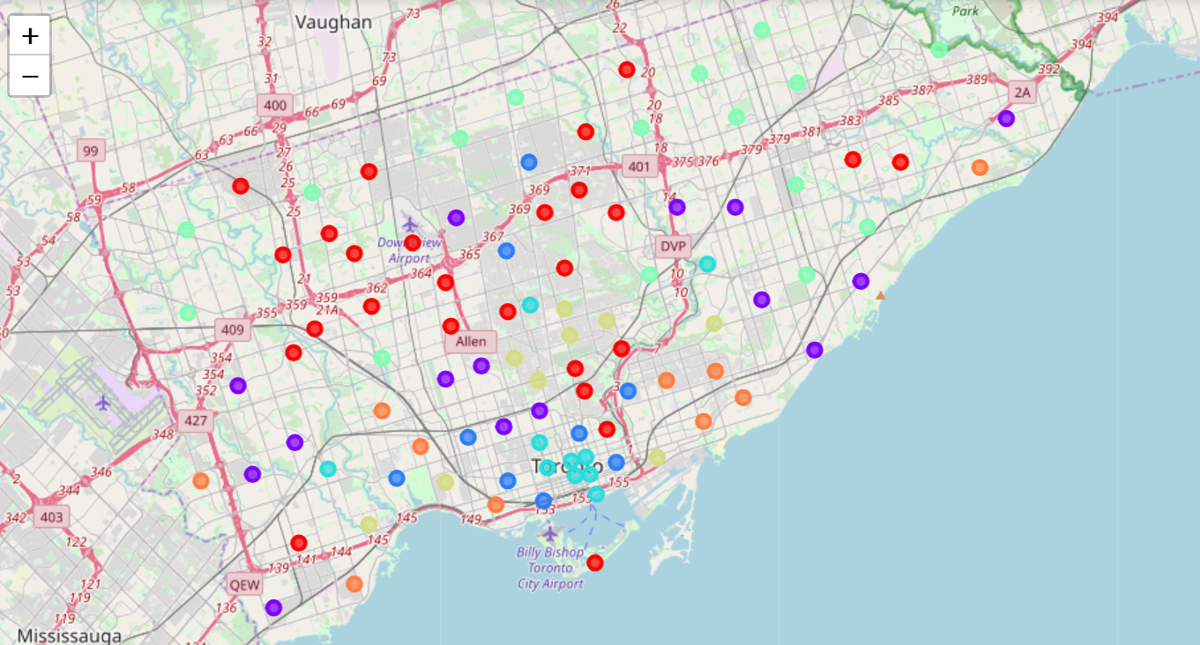
Cluster Analysis
Using Kmeans algorithm, found 7 clusters of FSAs in Toronto based on:
Population,
Number of Pet Licenses issued in 2017
Number of Existing Venues

Slide 8
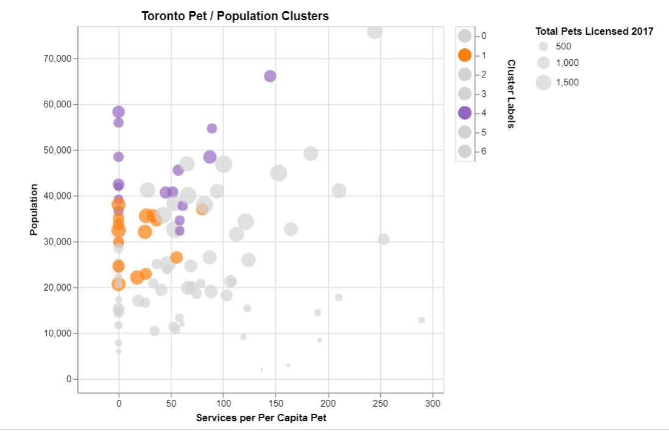
Clusters Ripe for more pet stores…
Clusters 2 and 4 look to be good candidates for new pet services
Low/zero existing services
High population
Moderate number of licensed pets
Within these clusters, 5 FSAs jump out
cluster 4
M2J, M9V,M1W, M6M
cluster 1
M6E, M9B

Slide 9
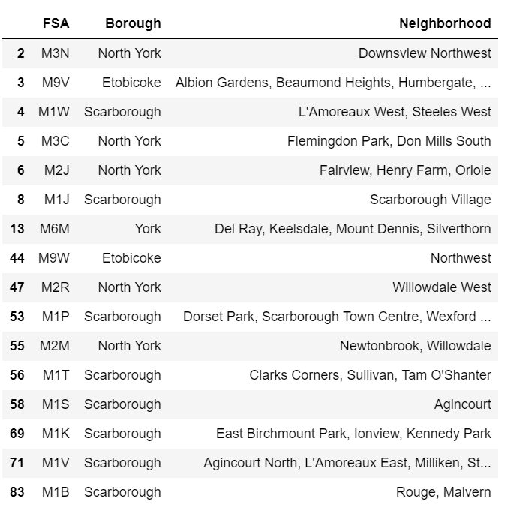
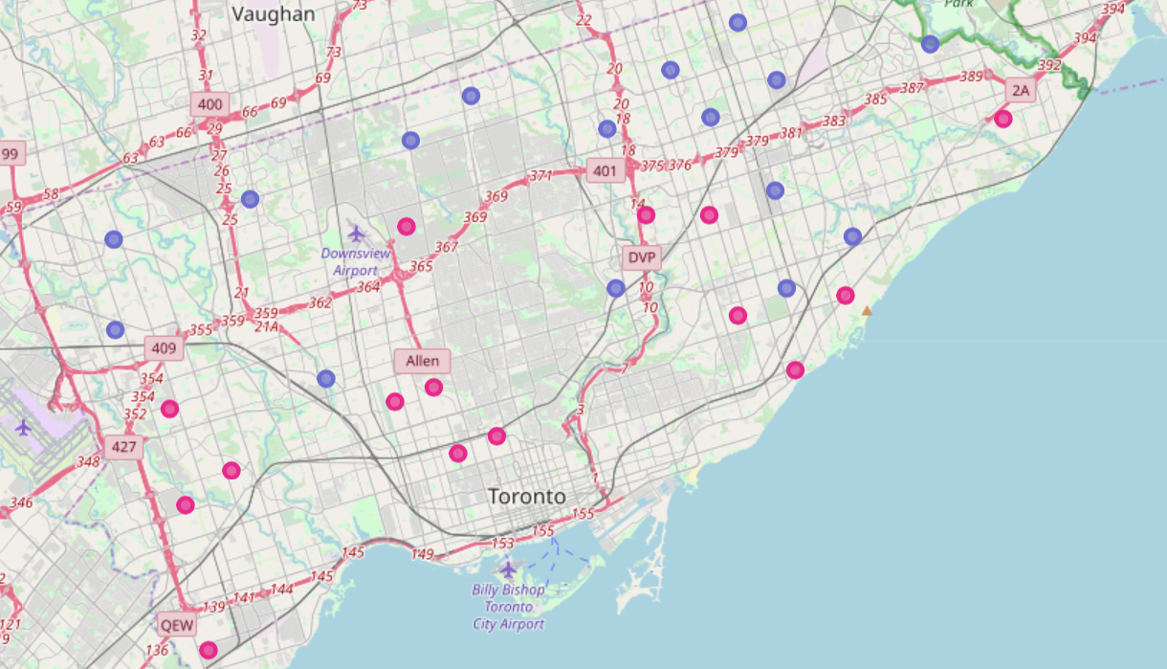
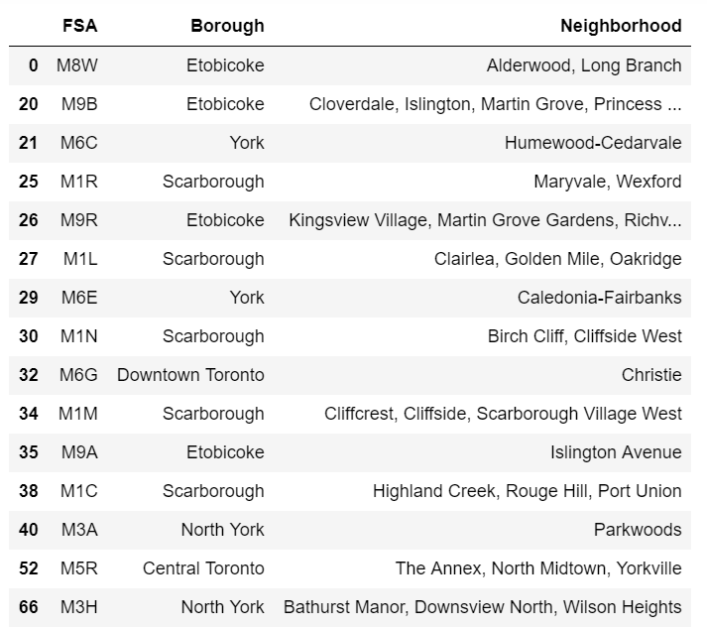
Where are these clusters?
Best Candidates:
Cluster 4: Purple
Cluster 1: Pink

Slide 10
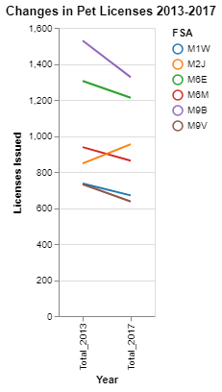
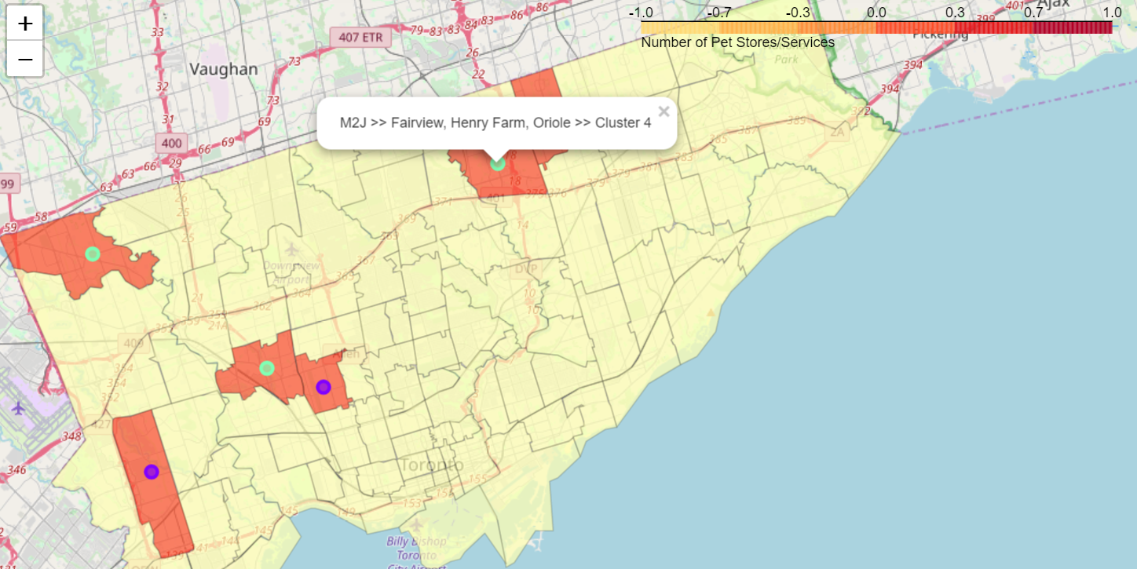
So where should I open my store?
M2J shows an increase in pets over last 5 years and may be particularly worth a closer look

